Slide 1
Algebraic Data Types Functional Programming
An alternative to OOP. Yes it does make sense. No it isn’t just C

Slide 2
Functional Programming for this talk
1st class functions
Functions are like ints or strings
Lots of syntactic sugar for functions
Functions = ☺
Functions in Functional Programming = Classes in Object Oriented Programming

Slide 3
What Are Algebraic Data Types (ADT)
Scary Name
Algebra with types(?)
Product Types and Sum Types
Replacement for inheritance

Slide 4
Product Type
AKA records/tuples/classes/structs
Collection of fields

Slide 5

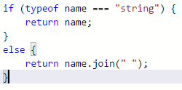
Sum Type/union type
Value could be one of several different types
Compare type to see what to do

Slide 6

Example – Pictur.IO
Picture is made up of shapes
Class hierarchy:

Slide 7
Pictur.IO – Saving approach #1
void Save(StreamWriter file) on base class, Circle/Square overrides
Switch from XML to json (to be webscale)?
Violates SoC

Slide 8
Pictur.IO – Saving approach #2
void Save(IShapeSaver) – on base class, Circle/Square say what to save
Better SoC
Swappable functionality
But SOOOOOO much work. We’re lazy, why type so much?
Adding load requires changing every class

Slide 9
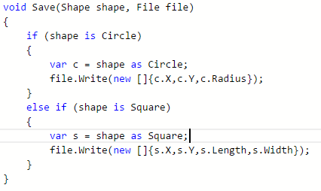
Pictur.IO – Saving Approach #3
Save method taking shapes as types
Comparing types and getting values
Better SoC
Swappable functionality
Less typing (but still too much ☹)
Could miss types (someone adds Triangle, forgets to put it here)

Slide 10
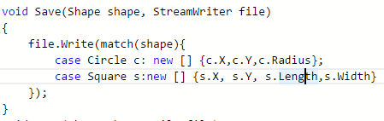
Pictur.IO – Saving Approach #4
Use ADT with match statement
Match = switch/case for “patterns”
Match type + creates alias
Better SoC
Swappable functionality
Very little typing
Forgetting types is a compile time error

Slide 11
How do I?
Constructors?
Factory methods. This is best practice anyways
Private functions?
Inner functions (functions inside functions)
Functions inside modules not exported
Private Data?
Separate interface or type for external and internal usage

Slide 12
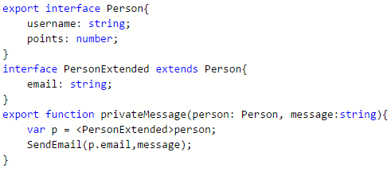
Private Data

Slide 13
Interfaces?
Mixins/Traits
Provided outside of type
Can provide traits for types you didn’t make

